Slide 1
ASYMPTOTIC NOTATION

Slide 2
Text Book
Text Books
Introduction to Algorithms (Third edition) Cormen, Leiserson, Rivest, and Stein
An excellent reference you should own
Data Structures and Algorithms in C++ Goodrich, Tamassia, and Mount

Slide 3
What is a Data Structure?
Data is a collection of facts, such as values, numbers, words, measurements, or observations.
Structure means a set of rules that holds the data together.
A data structure is a particular way of storing and organizing data in a computer so that it can be used efficiently.
Different kinds of data structures are suited to different kinds of applications, and some are highly specialized to specific tasks.
Data structures provide a means to manage huge amount of data efficiently.
Usually, efficient data structures are a key to designing efficient algorithms.
Data structures can be nested.

Slide 4
Types of Data Structure
Data structures are classified as either
Linear (e.g, arrays, linked lists), or
Nonlinear (e.g, trees, graphs, etc.)
A data structure is said to be linear if it satisfies the following four conditions
There is a unique element called the first
There is a unique element called the last
Every element, except the last, has a unique successor
Every element, except the first, has a unique predecessor
There are two ways of representing a linear data structure in memory
By means of sequential memory locations (arrays)
By means of pointers or links (linked lists)

Slide 5

Algorithm
An algorithm is a sequence of instructions that one must perform in order to solve a well-formulated problem.
Problem
Input
Output
Algorithms did not start with computers; they have been with us from ancient times; nor they are limited to computer science.

Slide 6
Algorithm
An algorithm is a sequence of computational steps that transform the input into the output.
Algorithms are the ideas behind computer programs.
An algorithm is a tool for solving a well-specified computational problem.
An algorithm is said to be correct if, for every input instance, it halts with the correct output.
An incorrect algorithm might not halt at all on some input instances, or it might halt with other than the desired output.

Slide 7

Program
A program is the expression of an algorithm in a programming language
A set of instructions which the computer will follow to solve a problem

Slide 8
Define a Problem and Solve It
Problem:
Description of Input-Output relationship
Algorithm:
A sequence of computational steps that transform the input into the output.
Data Structure:
An organized method of storing and retrieving data.
Our Task:
Given a problem, design a correct and good algorithm that solves it.
To design a good algorithm, find a suitable data structure.

Slide 9
Why Study Algorithms and Data Structures
You will be able to write better, faster and more elegant code.
You will be able to think more clearly, more abstractly and more mathematically.
You will be able to solve new problems.
You will be able to give non-trivial methods to solve problems.
You will improve your research skills in almost any areas.
It’s one of the most challenging and interesting area of Computer Science.

Slide 10
What Do We Analyze an Algorithm?
Correctness
Does the input/output relation match algorithm requirement?
Amount of work done (complexity)
Basic operations to do task
Amount of space used
Memory used
Simplicity, clarity
Verification and implementation.
Optimality
Is it impossible to do better?

Slide 11
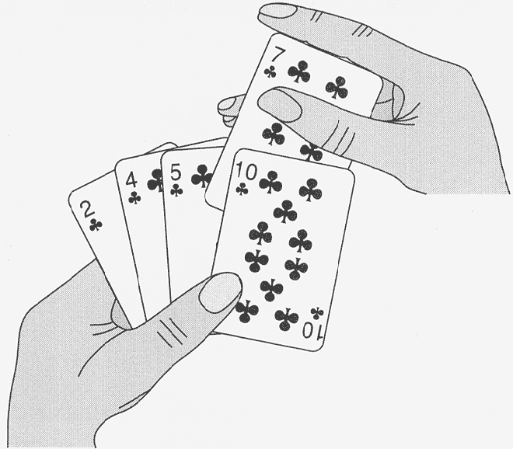
An Example of Insertion Sort

Slide 12
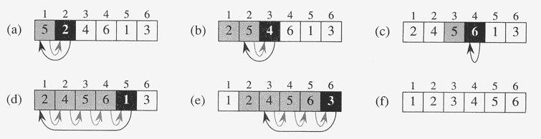
An Example: Insertion Sort
InsertionSort(A, n) {
for i = 2 to n {
key = A[i]
j = i - 1;
while (j > 0) and (A[j] > key) { A[j+1] = A[j]
j = j - 1
}
A[j+1] = key
}
}

Slide 13
An Example: Insertion Sort
Statement | Cost | Times
 | c₁ | n
 | c₂ | (n – 1)
 | c₃ | (n – 1)
 | c₄ | T
 | c₅ | (T – (n – 1))
 | c₆ | (T – (n – 1))
 | c₇ | (n – 1)
InsertionSort(A, n) {
for i = 2 to n {
key = A[i]
j = i - 1;
while (j > 0) and (A[j] > key){ A[j+1] = A[j]
j = j - 1
}
A[j+1] = key
}
}

Slide 14
Thank you!
Any Questions?

